Slide 1
IF 2025 Info Session: Budget
Ingi El Hadi – Director, Project Planning, Design & Construction, FMP
Ryan Farrell – Strategic Project Officer, CORIS
Sandra Nelson – Director, Strategic Procurement & Financial Information Systems, Procurement Services
Kate Swan – Research Facilitator, Institutional Initiatives, CORIS

Slide 2
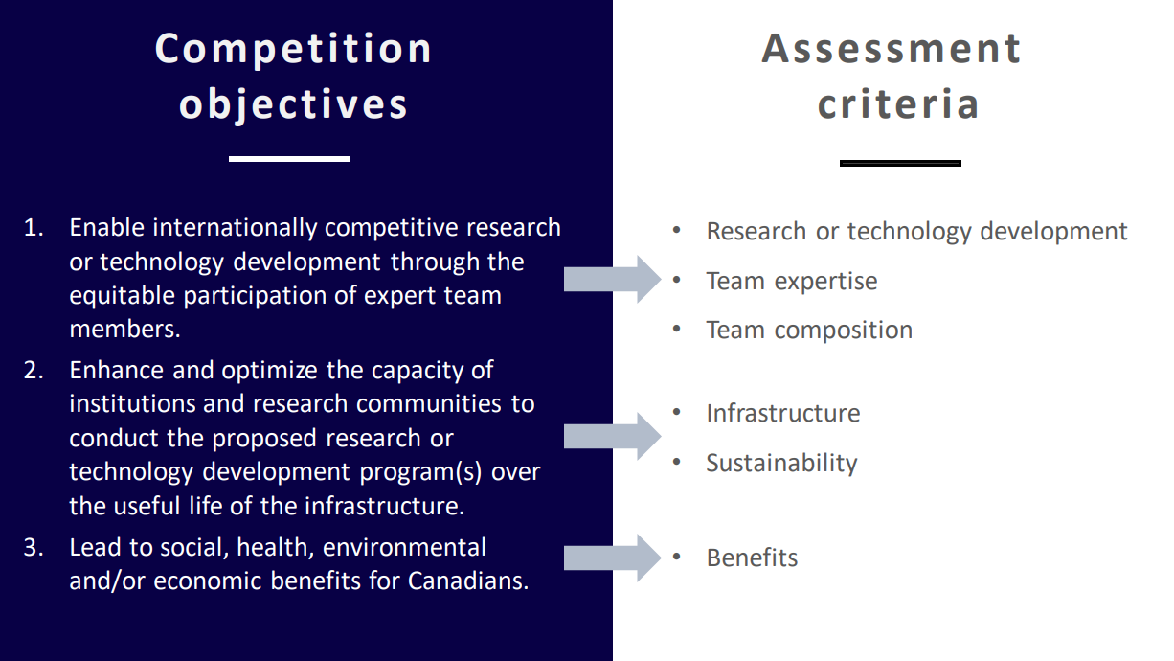
Overview
Notes:
Point here is a reminder of why we are doing this – i.e., hitting the second competition objective and meeting the assessment criteria related to infrastructure (The requested infrastructure is necessary and appropriate to conduct the proposed research program(s) and optimally enhances existing capacity) and sustainability (The infrastructure will be optimally used and maintained over its useful life through tangible commitments. )

Slide 3

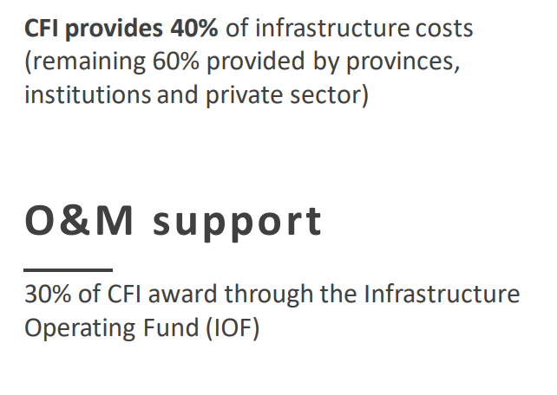

CFI Funding Model
Refer to Slide 18 for more tips on Operations and Maintenance

Slide 4

CFI Funding Equation
Equation based on 'Total Project Costs'
Total Project Costs = Cash Price + 'In-kind'
CFI - Prov. - (In-kind + other cash)
32% - 32% - 37%
Notes:
Hands on budget support

Slide 5

In-Kind Contributions
Definition: non-monetary resources that external partners offer as a contribution
CFI specific savings / discounts
  Must be noted on quote and invoice
Reported at fair market value
  Training/installation
  Donations (licensing/software)
  Space
Notes:
Beyond Educational/Academic discount
Repurposing can be eligible

Slide 6

Partner Cash Contributions
Eligible
Institutional funds, trust funds, foundations
Departments and agencies of Federal, provincial, territorial and municipal governments
Firms and corporations
Non-profit organizations
Individuals
Non-eligible
Tri-Agencies and federal program administered by Tri-Agency, e.g., CRC, CFREF, NFRF
ISED Programs: Knowledge Infrastructure Program and Strategic Investment Fund (SIF)
Notes:
Many great benefits as we can see in the following examples

Slide 7

Case #1: The ‘Ontario-only’ budget
Total project cost | $5,928,920
Amount request from CFI | $2,370,000
% requested from CFI | 40%
Collaborating Institutions | U Ottawa
CFI - Prov.- Other
40% - 40% - 20%
Partner type | Cash ($) | In-kind ($) | Total ($)
Institutional | 160,604 |  | 160,604
ORF LIF | 2,370,000 |  | 2,370,000
Vendor in-kind |  | 1,028,316 | 1,028,316
Total Elig. Contributions | 2,530,604 | 1,028,316 | 3,558,920

Slide 8
Case #2: The ‘multi-province’ budget
Total project cost | $9,050,481
Amount request from CFI | $3,350,000
% requested from CFI | 37%
Collaborating Institutions | McGill, UBC, Sherbrooke
CFI - Prov.- Other
37% - 37% - 26%
Partner type | Cash ($) | In-kind ($) | Total ($)
Institutional | 1,816,053 |  | 1,816,053
Provincial (ORF, BC, QC) | 3,350,000 |  | 3,350,000
Vendor in-kind |  | 534,428 | 534,428
Total Elig. Contributions | 5,166,053 | 534,428 | 5,700,481

Slide 9
Case #3: The ‘international consortium’ budget
Total project cost | $29,424,215
Amount request from CFI | $6,185,485
% requested from CFI | 21%
Collaborating Institutions | McGill, SFU, U Vic
CFI - Prov.- Other
21% - 0% - 79%
Partner type | Cash ($) | In-kind ($) | Total ($)
International Consortium | 23,238,730 |  | 23,238,730
Institutional/Provincial
Vendor in-kind
Total Elig. Contributions | 23,238,730 |  | 23,238,730

Slide 10

Eligible Cost Highlights
  Research equipment, warranties
  Installation
  Shipping, transportation, brokerage fees, excise taxes and duties
  Travel to a manufacturer, dealer or supplier to select research infrastructure
  Initial training for the main operator(s) that is typically included with purchase
  Furniture, communications, databases, etc. where justifiably linked to research
  Prior to submission:
  When incurred before the CFI deadline, as long as within the eligible time window (usually 12 months before CFI releases CFP)
  Feasibility test
  Renovations funded by Faculty/Dept (where applicable in future)

Slide 11

Ineligible Costs
  Purchase or lease of real property
  Infrastructure that is primarily use for teaching and/or clinical care
  Office furniture and supplies
  Internal fees for the use of CFI-funded infrastructure
  Operating costs related to the general maintenance and overhead of the research infrastructure and of the building or other facilities
  Supplies and consumables
  Trainee stipends and research salaries
  Research related costs (i.e. data collection, recruitment, publication fees)
  Conference travel
  Administrative costs
Notes:
This is an infrastructure grant!

Slide 12

Operations & Maintenance
Keys for Success:
Think about the useable life of the infrastructure & beyond IOF
  Personnel – lab management
  Supplies/Consumables needed for operation
  Maintenance – replacement parts, repairs, warranties
  Services – electricity, security, cleaning
How will facilities be maintained?
  Institutional Commitment (IOF)
    CFI will provide 30% of the CFI contribution
    Carleton uses 5% to cover utilities and space-related costs
    Remainder can be allocated to support Operations/Maintenance
  Operating Grants
  Departmental support
  User fees
Sustainability Assessment Criteria:
The infrastructure will be optimally used, operated and sustained over its useful life through tangible commitments
Notes:
Long term sustainability?
How will operations be funded beyond 5 years?
Are all considerations being made?
Is there a business case to be made? Well organized?
Multi-institutional O&M rewarded

Slide 13

Best Practices
Think outside & inside the box!
  Size, shape, weight, special power requirements, etc.
Group your budget items!
Factor in exchange rates, shipping, duty, etc.

Slide 14
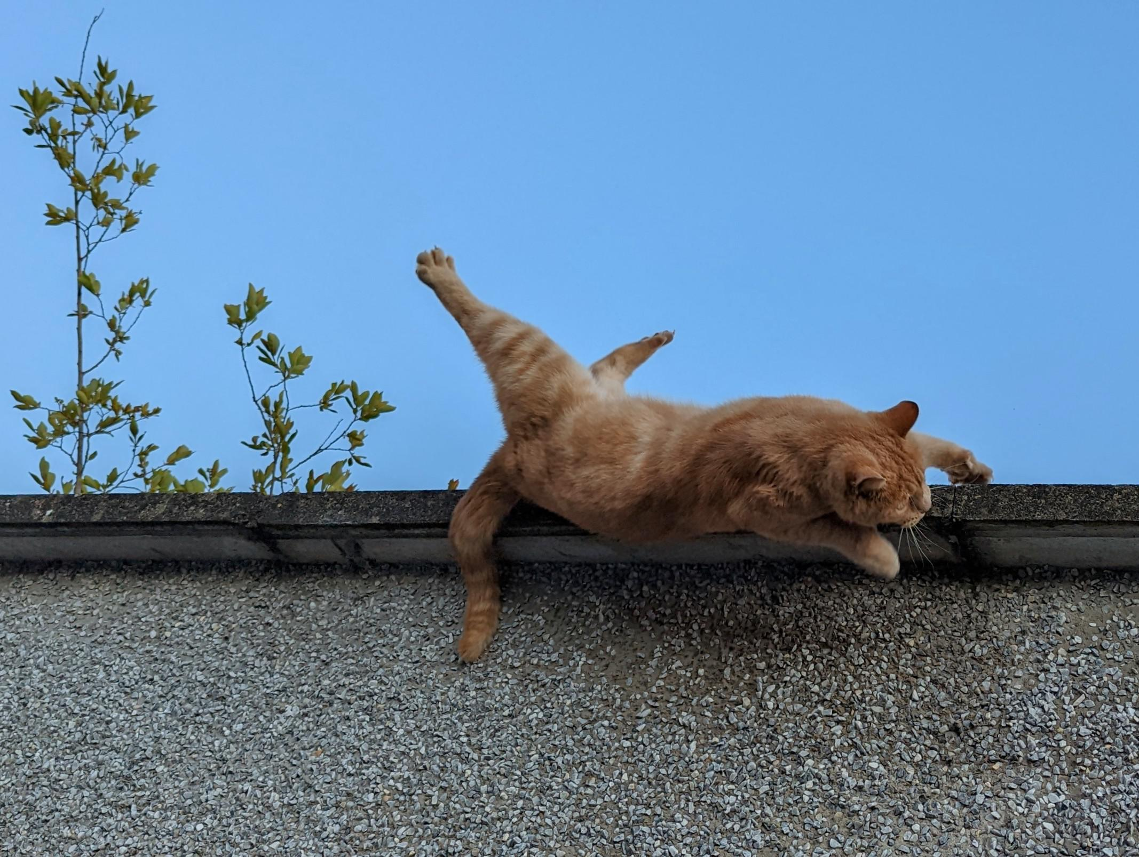
Common Pitfalls
Not thinking about how an item will fit into a space
Negotiating too hard with vendors or committing to a specific vendor
Not including buffer for exchange rates, brokerage fees, etc.
Forgetting to account for software licenses
Not thinking about who will operate infrastructure as part of O&M

Slide 15
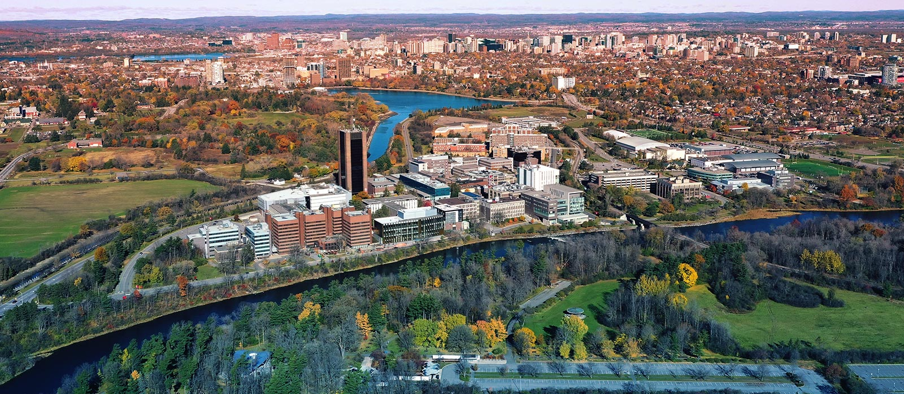

Space
Engage your Faculty/Department early to confirm suitable space to house your proposed equipment!

Slide 16

Construction
Eligible costs
Direct construction costs (space to house infrastructure, space to use infrastructure, etc.)
Soft costs (site planning, architectural, permits, etc.)
Contingency costs (10%)
Ineligible costs
Space for non-research costs
Space to house non-eligible equipment
Office space for faculty, admin, students
Admin costs
Application requirements
Complete description of space
Timeline
Floor plans
Detailed cost breakdown (class D estimate)
Top tips
Start early!
Scope needs to be reasonable
Under 20% of project costs
Start discussions with FMP, via CORIS/Faculty, ASAP!

Slide 17


Quotes
CORIS requires 1 quote/item at application stage
Why?
Notes:
These are not sent to CFI they are for us to ensure reasonable, implementable as proposed as this is a grant to Carleton not project team
It is NOT necessarily what you are buying!
As reminder if quote has discount it needs to be specific to CFI

Slide 18


Areas of Focus
Strategic Integrated Plan
  Share Knowledge, Shape the Future
  Serve Ottawa, Serve the World
  Strive for Wellness, Strive for Sustainability
F&A Commitments:
  Partner with stakeholders
  Enable our people
  Pursue excellence in the everyday
  Embed ESG principles

Slide 19
Budgeting for your CFI Project
Procurement Implications
CFI requires that all CFI purchases follow the usual institutional tendering and purchasing policies and procedures
To reduce the administrative burden, this should only happen once, prior to the purchase of an item
That means that during your proposal and finalization stages, you are working with estimates and quotes only
  Obtaining quotes and estimates does not constitute a commitment; this should be communicated to vendors and contractors
  Naming a vendor or contractor in your application without having gone through a formal procurement process does not guarantee they will be awarded any contract or purchase
  Reach out to Procurement Services for support with budgetary quotes

Slide 20
Once your CFI Project is Awarded
Procurement Implications
Purchases < $100,000
  Refresh your quotes from vendors, or obtain new ones in accordance with purchasing policies and procedures
  Review refreshed quotes for any differences in the recorded discounts or in-kind at this stage (e.g., deletion, omission, variation in amount)
  If you need help with eShop, let us know!
Purchases >= $100,000
  Ensure adequate time is built into your project to carry out an open competitive procurement
  Purchases that you plan to single or sole source must meet a valid limited tendering exception; in some cases, an Advanced Contract Award Notice may be required

Slide 21
Things to think of together with the Procurement Implications
Situations have arisen where it has been found impossible to install equipment purchased from academic, administrative and research budgets in a desired location because of the inability of the building structure, services, building codes, or fire regulations, to permit its installation
To enable the modification or planning of suitable facilities for such equipment in adequate time to enable installation on arrival, and to confirm total cost before commitment, the following apply.
Requires:
Equipment which because of its operation or bulk:
to be secured by bolting or welding to floors, walls, roofs, or suspending from ceilings;
cutting holes through any wall, floor, roof or other part of the structure;
the extension of electrical or mechanical services for its operation;
a power supply in excess of 5KW @ 120/208V single phase or three phase or 20KW @ 600V three phase.
has a gross weight in excess of 100 lbs. per sq.ft. if floor or roof mounted;
has a gross weight in excess of 200 lbs. when wall mounted;
has a gross weight in excess of 10 lbs. per sq.ft. when suspended from ceilings;
will create vibration to a building structure when operating;
will create a noise nuisance when operating;
has overall dimensions which will prevent its installation in a building without the removal of door frames, windows or enlargement of existing accesses.

Slide 22
Intake Process and Points of Contact
Project Requirements
(CORIS)
Infrastructure¹
Integration Team (PDC)
Equipment and Services² (>=$100k)
Open Competitive Procurement Request
Equipment and Services (<$100k)
Project Request
Procurement Services
Procurement Services
Request for Procurement Support
Project Execution and Delivery (PDC)
Procurement Services
A project manager (PDC) and procurement officer (PS) will be assigned to your project team
Infrastructure means any construction or renovation, including equipment that is fixed to, or contingent on the physical design of the space
When procuring equipment or services separately and stand-alone from any construction or renovation project.

Slide 23
Project Initiation Stage (Approx 3.0 months)
Project Request Form
Stakeholder, description & budget source
1 day
Project Initiation
User Engagement, information gathering, preliminary assessment, project duration
Approx 3 months
Concept Stage (30%)
Initial Design, visuals, Schedule of Accommodations, Class D estimates etc
Approx 3 months
Preliminary Stage (70%)
Tender Stage
Call for RFP (Prime Consultant) -PDC Procurement overview
Preliminary Architectural drawings, Room Data Sheets, Simulations, Sustainability Strategies & Class C Estimates
Detailed Design Stage (99%)
Approx 4 months
Detailed Drawings, cutsheets, specifications, material selection, value engineering , Class B estimate
Approx 4 months
Tender Documents, Specifications, Tender Drawings, Evaluation, Class A Estimates
Approx 4 months
Identifying project team members (Senior Project Manager, Project Managers and Project Coordinators)
Project Appreciation
(2 weeks)
Stakeholder Engagements
(3 weeks)
Preliminary Project Assessment, Scope of works & budget
(4 weeks)
Establish Project Duration & Identifying Project execution Key team members
(1 week)
Prepare RFP documents and scope of works
(3 weeks)
Call for RFP & Award (Prime Consultant)
(3 months min.)

Slide 24
Project Workflow, Process and Timeline
Up to 18months
of back end works
before construction,
Testing & commissioning
and handover
Project Request Form
Stakeholder, description & budget source
1 day
Project Initiation
User Engagement, information gathering, preliminary assessment, project duration
Approx 3 months
Concept Stage (30%)
Initial Design, visuals, Schedule of Accommodations, Class D estimates etc
Approx 3 months
Preliminary Stage (70%)
Tender Stage
Call for RFP (Prime Consultant) -PDC Procurement overview
Preliminary Architectural drawings, Room Data Sheets, Simulations, Sustainability Strategies & Class C Estimates
Detailed Design Stage (99%)
Approx 4 months
Detailed Drawings, cutsheets, specifications, material selection, value engineering , Class B estimate
Approx 4 months
Tender Documents, Specifications, Tender Drawings, Evaluation, Class A Estimates
Approx 4 months
Identifying project team members (Senior Project Manager, Project Managers and Project Coordinators)

Slide 25

Reminders & Resources
CORIS EOI deadline – December 1, 2023
EDI info session – November 15 10am-12pm
  Register here!
CORIS CFI IF website

